Slide 1
SPREADSHEET, HIGHLIGHT AND HEAP MAP TABLE

Slide 2
SPREADSHEET
A spreadsheet is an interactive computer application for analysis and storage of data in tabular form.
The data is entered in cells of a table where each cell may contain either numeric or text data, or the results of formulas that automatically calculate and display a value based on the contents of other cells.

Slide 3
CONNECTING TO EXCEL DATA
The first step is to connect the data in Excel format to Tableau. An excel file is
connected in the form of
.xls
or
.xlsx
files.
Steps
Under the
Connect
tab, click
Excel
to import the data into the tableau
workspace.
Under the
Sheets
tab, all the sheets in the workbook will become visible.
Choose the one which you intend to analyze.
Double click on the selected sheet, and it opens like a spreadsheet.

Slide 4
USING DATA INTERPRETER TO CLEAN THE DATA
Though the entire data has been transported into the Tableau workspace, it appears that the data is not in the correct format. Data Interpreter is here to help.
Under the sheets tab, click on the option and the data gets formatted nicely.
Data Interpreter
To understand how the formatting takes place, click on the
Review the
results
tab.
Connecting the additional data:
●
Add
next to the Connections and selecting another excel file. All the files
now appear in the view.

Slide 5
RESHAPING DATA
PIVOT TABLE
A Pivot Table is used to summarise, sort, reorganise, group, count, total or average data stored in a table. It allows us to transform columns into rows and rows into columns. It allows grouping by any field (column), and using advanced calculations on them.
SPLIT
Custom Split

Slide 6
DATA BLENDING
Data blending brings in additional information from a secondary data source and displays it with data from the primary data source directly in the view
Exporting crosstab data from Tableau to Excel
Feature of Tableau which allows us to copy and paste data very easily from Tableau to Excel and vice versa.

Slide 7
HIGHLIGHT TABLE
In Tableau, you create a highlight table by placing one or more dimensions on the Columns shelf and one or more dimensions on the Rows shelf.
Highlight tables enhance text tables while keeping their form.

Slide 8
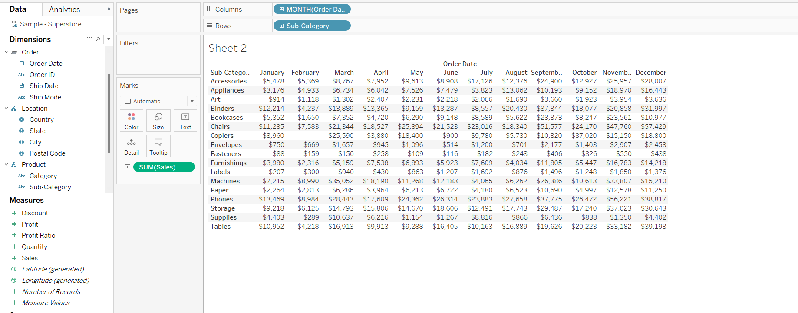
Measure as sales
Dimensions as sub-category and month of order date
Label of the mark card as sum(sales)

Slide 9
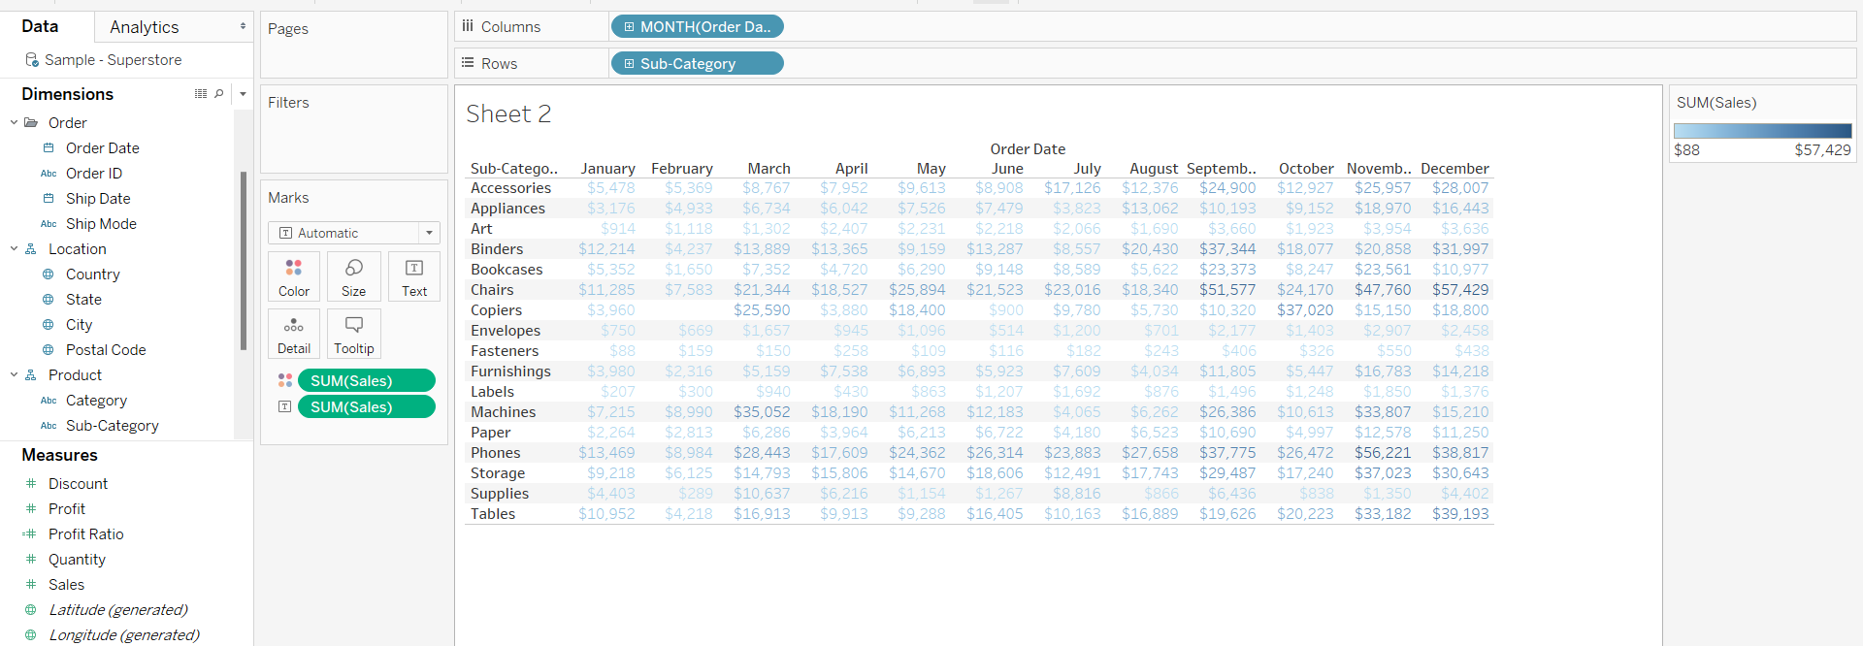

Dragging the sales measure from the measure list to the color marks card.

Slide 10
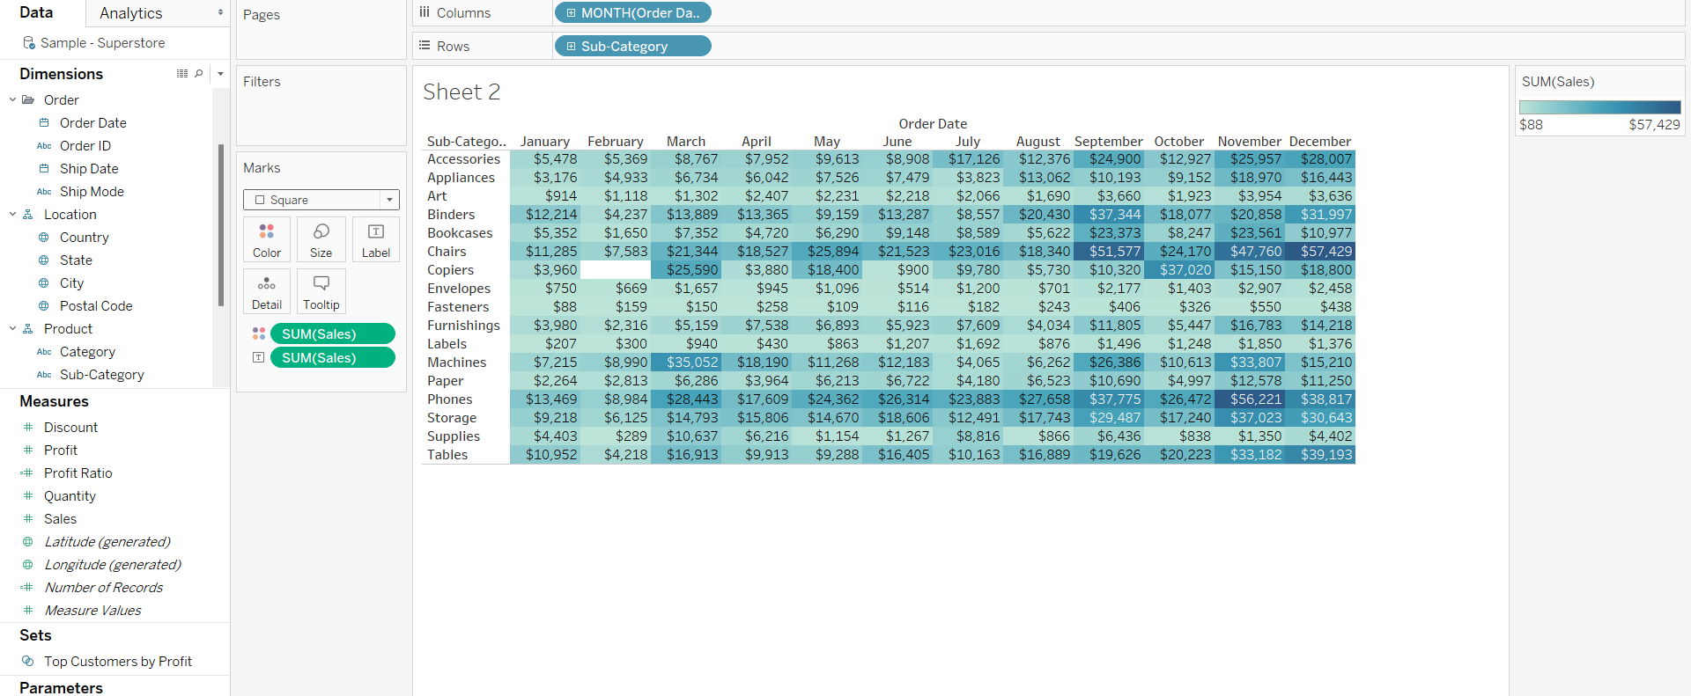

Create a highlight table by changing the mark type (automatic to square)

Slide 11
HEAP MAP TABLE
The heap map is used to visualize the data in the form of size and color on different measures.
Two different measures are visualized simultaneously using a heap map. One measure is assigned to size, whereas another measure is attached to the color of the heap map.

Slide 12
Measure as sales
Dimensions as sub-category and month of order date
Label of the mark card as sum(sales)

Slide 13
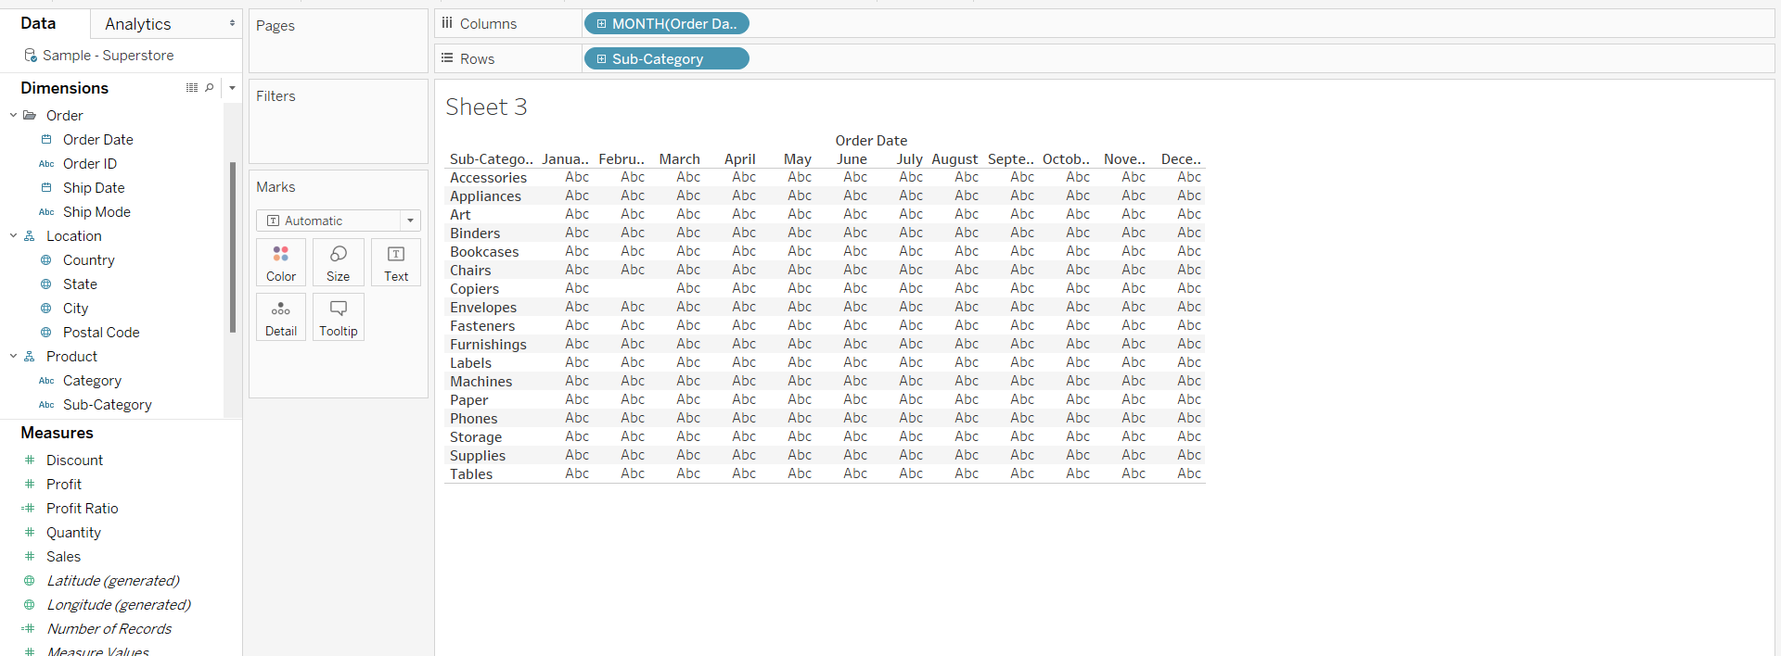
Put the month of Order Date dimension on the Column Shelf.
Put the sub-category dimension on the row shelf.

Slide 14
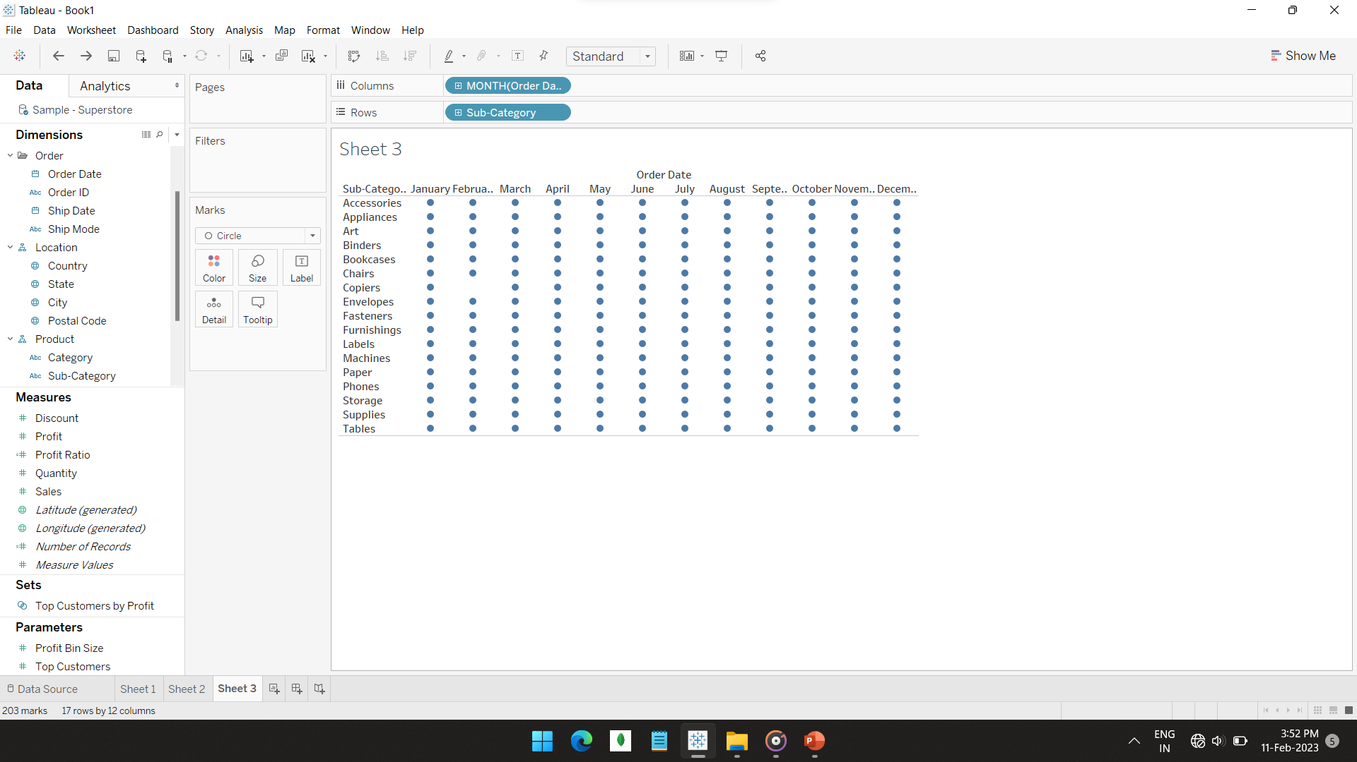

To prefer heap map to be created with circles , so change the mark type (automatic to circle)

Slide 15
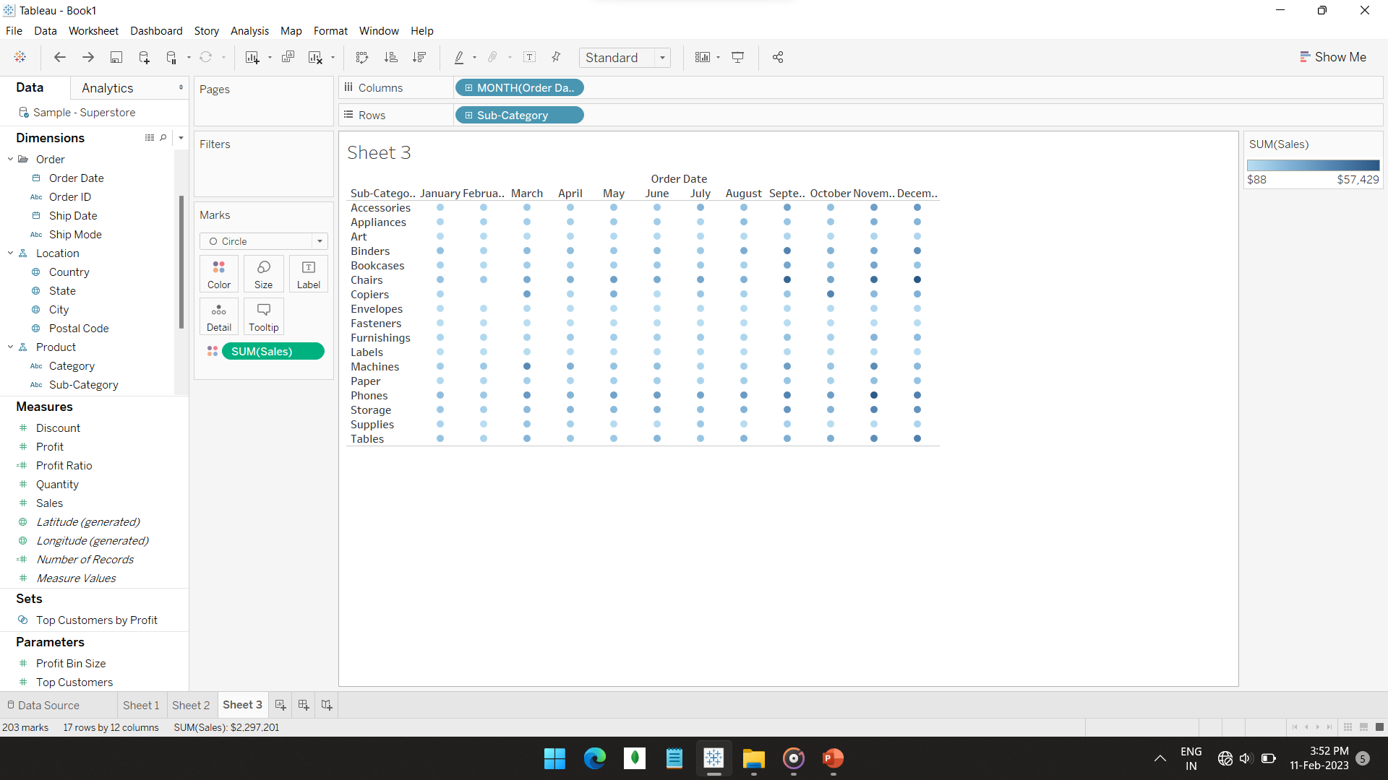

The sales measure on the color of mark card

Slide 16
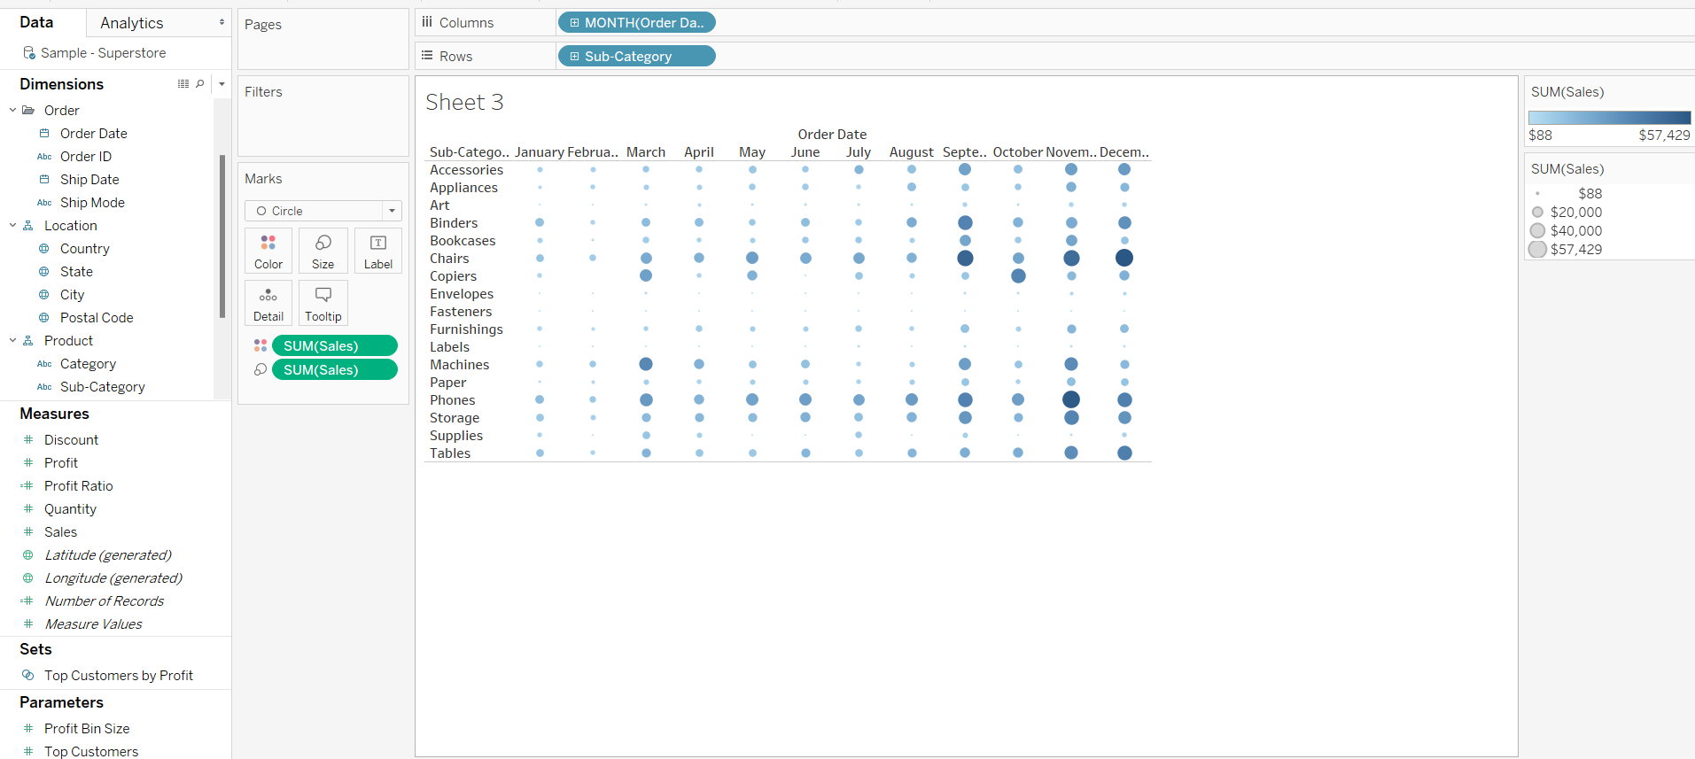

The sales measure on the size of mark card and change the size of circle.

Slide 17
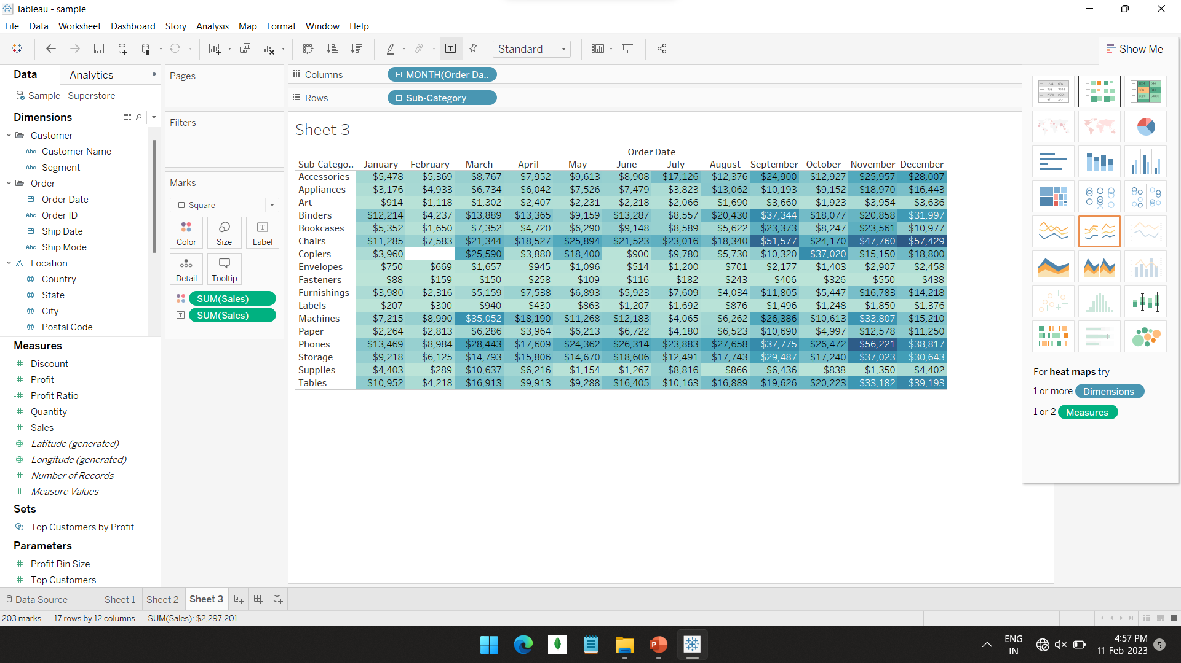

Show me option

